Slide 1
Microservices and DevOps
DevOps and Container Technology
Docker Exercise
Henrik Bærbak Christensen

Slide 2
Exercise 1
Go over the exercise at
https://github.com/docker-for-data-science/docker-for-data-science-tutorial/tree/master/exercises/02_dockerfile_essentials
Create a python ‘hello world’ program, copy it to the container in folder ‘/app’ and run it upon container startup.

Slide 3
Exercise 2
Create a ‘Hello (yourname)’ web server container.
Base it upon base image: henrikbaerbak/jdk8-gradle
Make it contain a /root/hello WORKDIR
In this, have the following ‘build.gradle’ file (in /root/hello)
And have ‘HelloSpark.java’ file (in /root/hello/src/main/java/example/)
/* Build file hello-spark */
plugins {
id 'java'
}
repositories {
mavenCentral()
}
dependencies {
// Use the SparkJava web server framework
implementation group: 'com.sparkjava', name: 'spark-core',
version: '2.9.3'
}
task hello(type: JavaExec) {
group 'SWEA'
description 'Dependency management demonstration'
main = 'example.HelloSpark'
classpath = sourceSets.main.runtimeClasspath
}
package example;
import static spark.Spark.*;
public class HelloSpark {
public static void main(String[] args) {
get("/hello/:name",
(req, res) -> "<H2>Hello to you "+req.params(":name")+"</H2>");
}
}

Slide 4
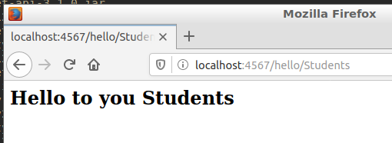
Exercise 2
When run, do run ‘gradle hello’
Output required:
Open firefox on ‘localhost:4567/hello/(name)’

Slide 5
Exercise 3
Create your own Docker hub account and upload the previous images.
Let your team mates pull and run your uploaded images.

Slide 6
Exercise 4
Start on the ‘image-dockerfile’ mandatory exercise…
And the ‘volume-mount’ exercise

